Slide 1

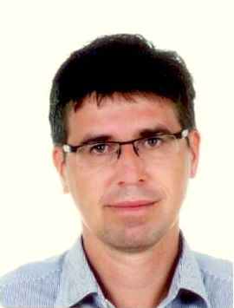

Digital Image Analysis in Transcranial Sonography
25th Conference of the European Society of
Neurosonology and Cerebral Hemodynamics
David Školoudík
Ostrava University Medical Faculty, Czech Republic

Slide 2
Transcranial sonography
The main limitations of TCS are 1/ a quality of temporal bone window and 2/ a dependency on sonographer experience and skill.
There is worse orientation in imaged brain structures due to small bone windows, which do not allow to obtain parallel sections as in CT or MR.
Fusion imaging technique enables to reduce these limitations.
Školoudík D, Walter U. Method and validity of transcranial sonography in movement disorders. Int Rev Neurobiol 2010;90: 7-34.

Slide 3
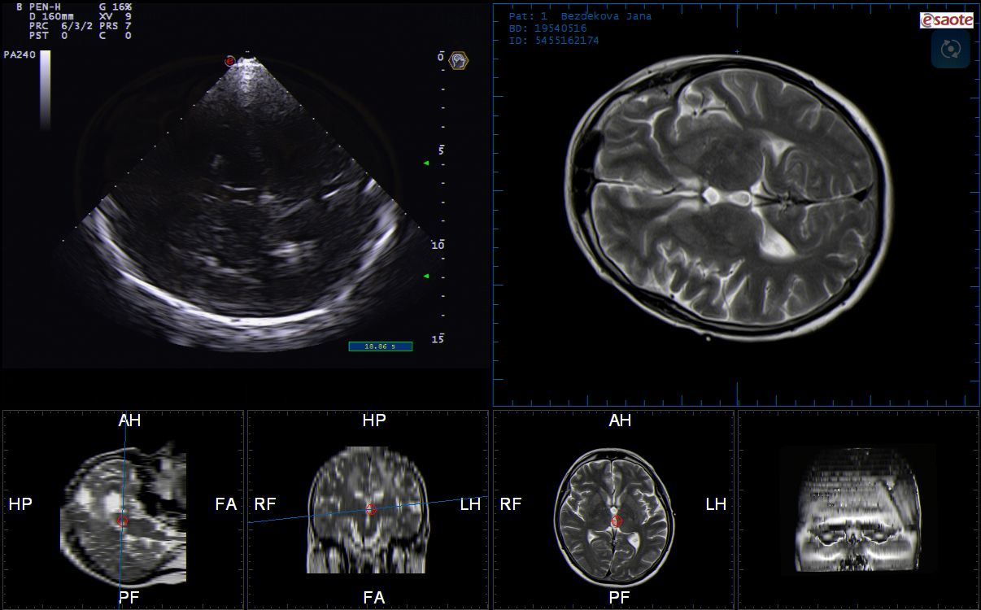

Slide 4
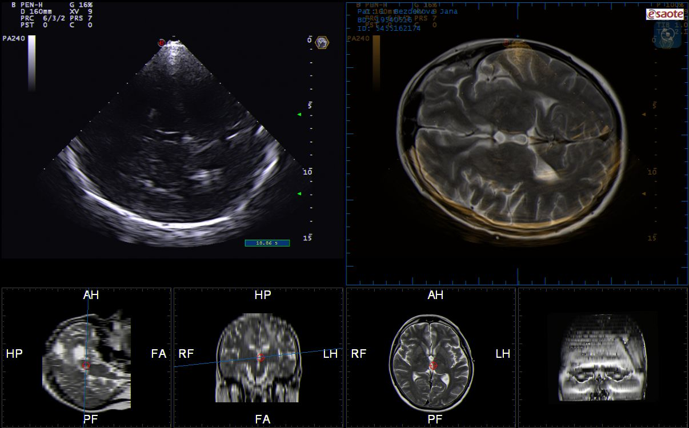

Slide 5
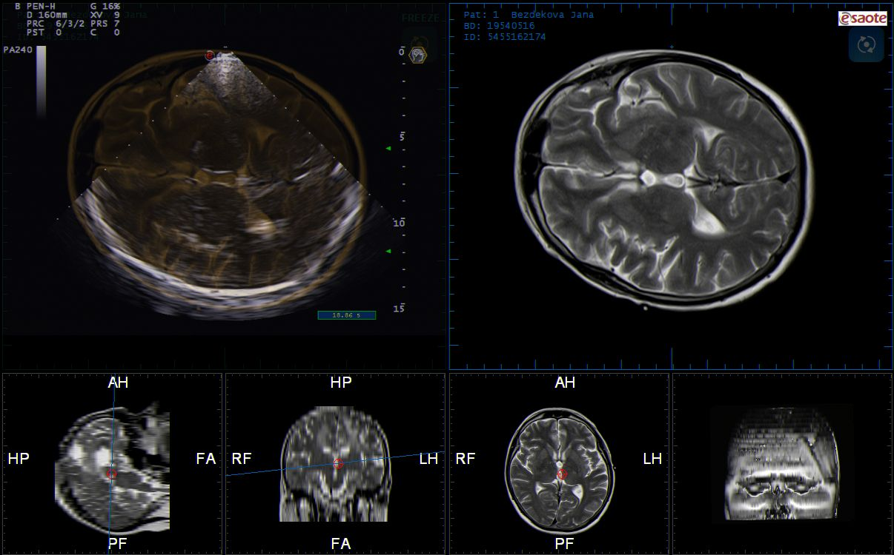

Slide 6
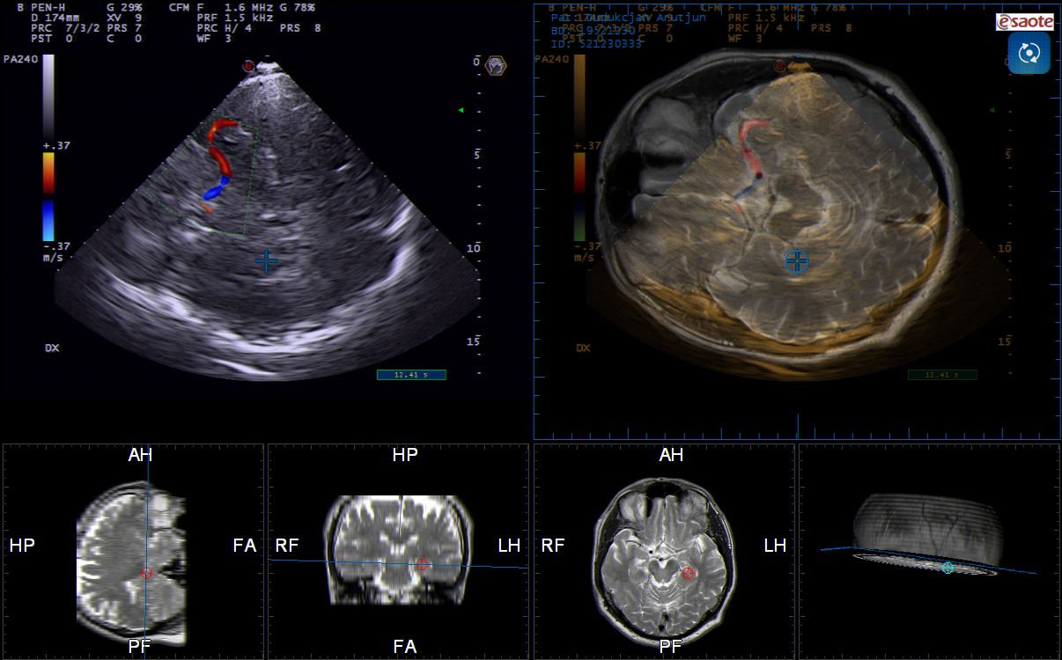

Slide 7
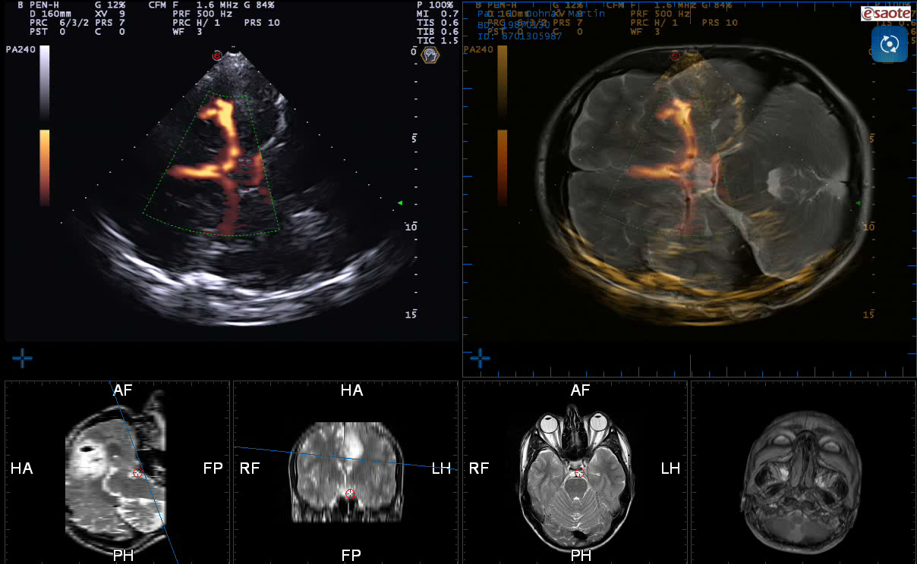

Slide 8
TCS/MR Fusion Imaging technique
Enables to identify and delineate brain structures more accurately
Enables also to evaluate echogenicity of more brain structures

Slide 9
Limitations of visual evaluation of brain structures
Different intensity and contrast of the image
Dependency on the quality of temporal bone window
Optimalization of the image using gain and postprocessing tools
Visual evaluation is dependent on the room lighting, screen brightness, sonographer´s fatigue, etc.
All these factors decrease the reproducibility of echogenicity evaluation

Slide 10
Digitized Image Analysis
Semi-automatic or automatic detection of intracranial structures with quantitative evaluation of echogenicity (structure, composition) of predefined brain structures

Slide 11
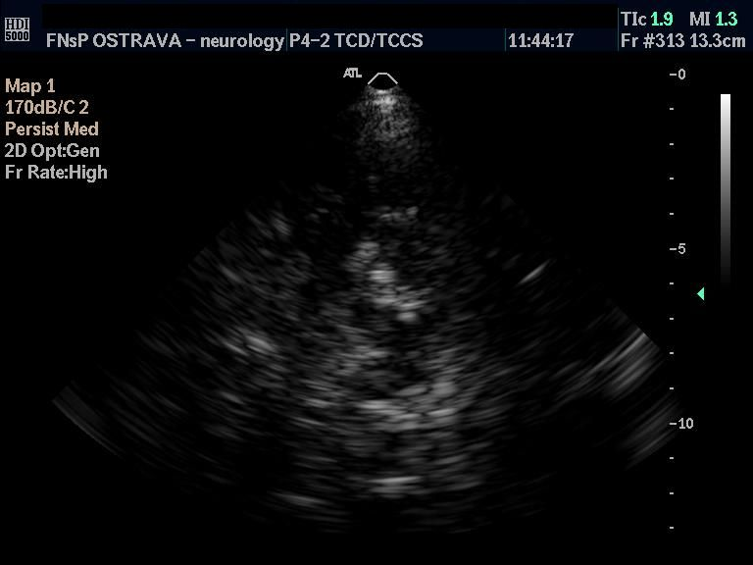
Substantia nigra

Slide 13
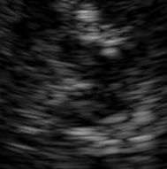

Slide 15
Evaluation of substantia nigra
Measurement of echogenic area
normal < 0,20 cm²
border line 0,20 – 0,25 cm²
pathological > 0,25 cm²

Slide 16
Grade | Echogenita
Grade I | Anechogenic (echolucent) – equal echogenicity to brain stem
Grade II | Normal echogenicity – low echogenic but good visible
Grade III | Hyperechogenic – echogenicita in lower than echogenicity of perimesencephalic cisterns
Grade IV | Hyperechogenic – equal echogenicity to perimesencephalic cisterns
Grade V | Hyperechogenic – echogenicita in higher than echogenicity of perimesencephalic cisterns
Evaluation of substantia nigra

Slide 17
Correlation between SN area and SN echogenity
1,20
1,00
,80
SN area
,60
,40
,20
0,00
N =
26
20
55
62
1
2
3
4, 5
SN echogenicity

Slide 18
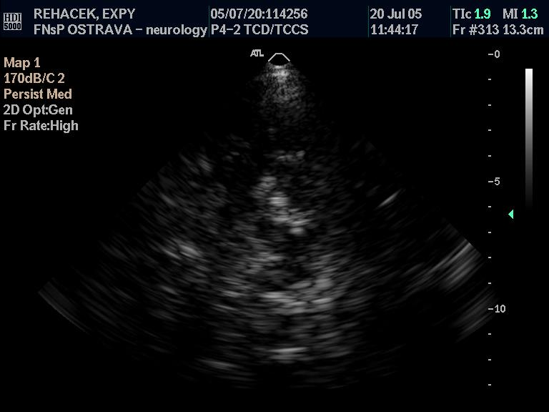
Enlarged hyperechogenic SN

Slide 19
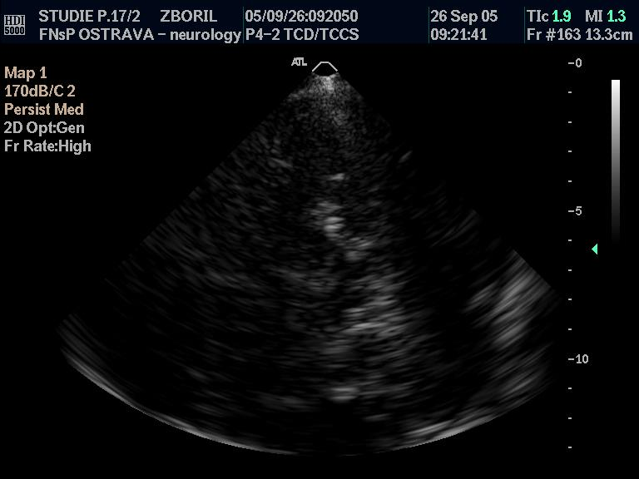
Hyperechogenic small SN

Slide 20
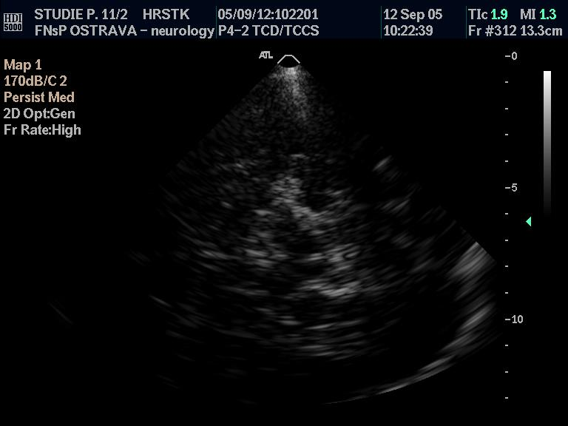
Normal echogenicity enlarged SN

Slide 21
The investigator’s experience and skillfulness are associated with a potential subjective bias in evaluation of TCS brain structures echogenicity.
Several approaches for automated SN detection and quantification of its echogenicity have been published recently, including principal component analysis-based artificial neural networks, active contour segmentation algorithms, invariant scale blob detection, and 3-dimensional SN detection (volumetry) based on random forests.
Chen L, Hagenah J, Mertins A. Feature analysis for Parkinson's disease detection based on transcranial sonography image. Med Image Comput Comput Assist Interv 2012; 15: 272 – 279
Blahuta J, Soukup T, Čermák P. The image recognition of brain-stem ultrasound images with neural network based on PCA. In: Savino M, Andria G. (eds.): 2011 IEEE International Symposium on Medical Measurements and Applications (MeMeA 2011) Proceedings. Bari: IEEE, 2011: 134 – 142
Sakalauskas A, Lukoševičius A, Laučkaitė K et al. Automated segmentation of transcranial sonographic images in the diagnostics of Parkinson's disease. Ultrasonics 2013; 53: 111 – 121
Pauly O, Ahmadi SA, Plate A et al. Detection of substantia nigra echogenicities in 3D transcranial ultrasound for early diagnosis of Parkinson disease. Med Image Comput Comput Assist Interv 2012; 15: 443 – 450

Slide 22
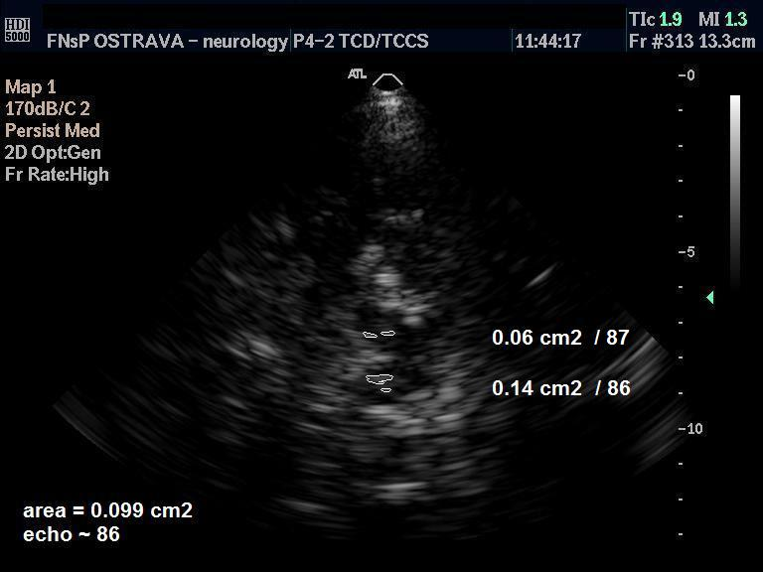

Slide 23
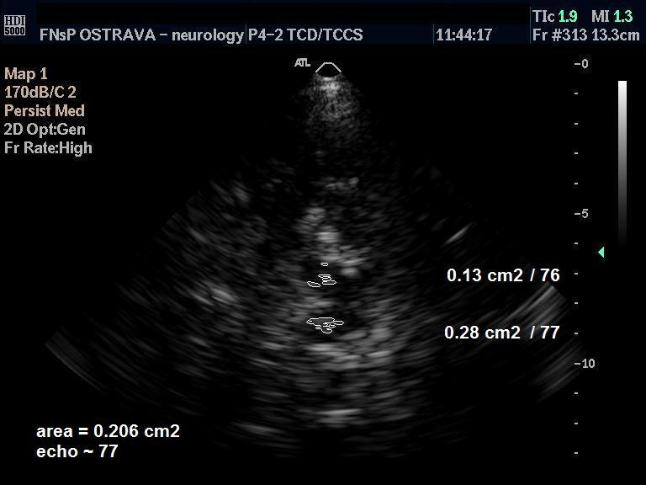

Slide 24
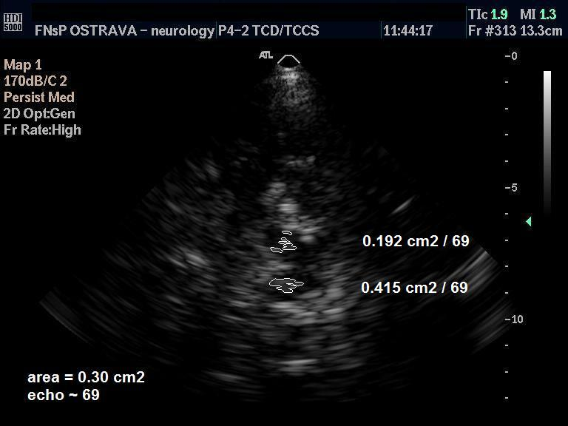

Slide 25
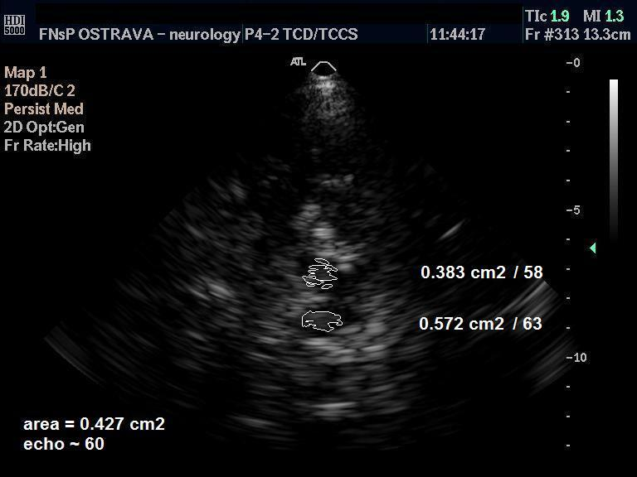

Slide 26
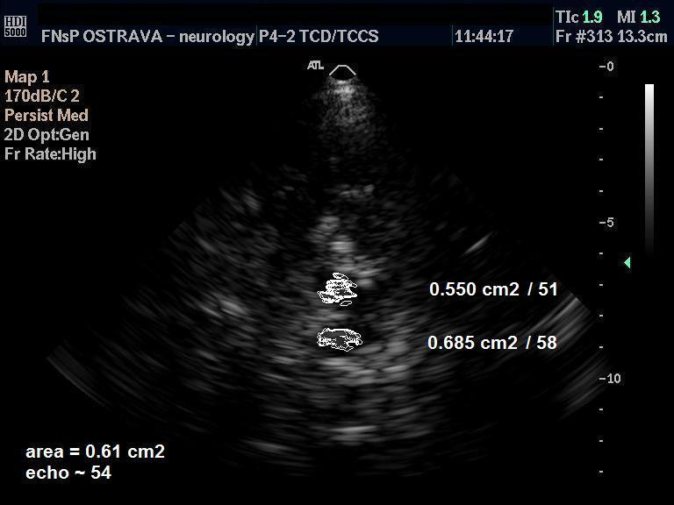

Slide 27
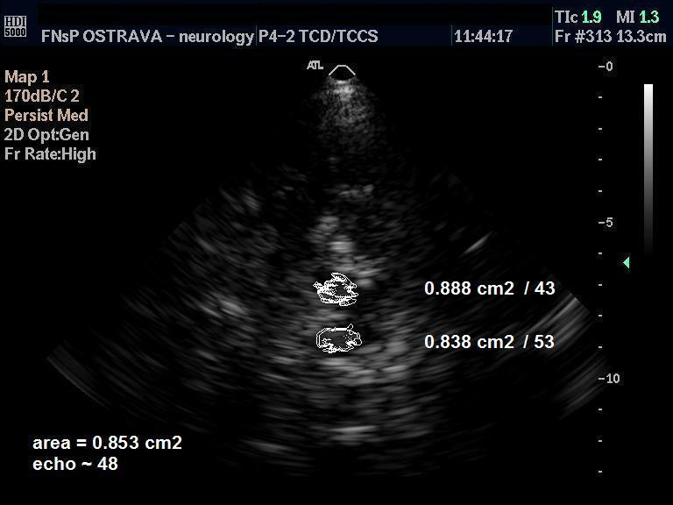

Slide 28
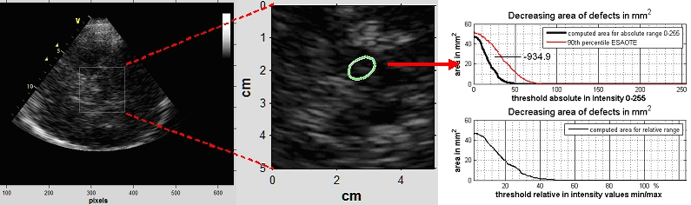
B-Mode Assist program

Slide 29
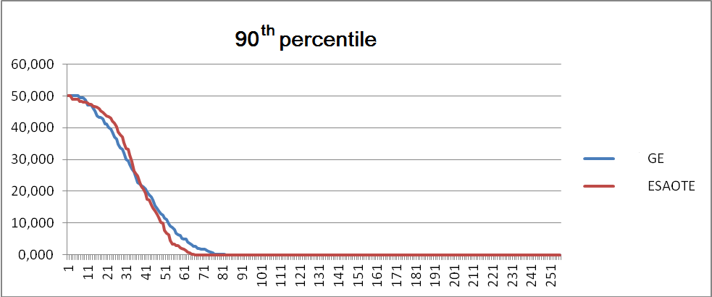
90th percentile
Blahuta J, Soukup T, Jelinkova M, Bartova P, Cermak P, Herzig R, Skoloudik D. A new program for highly reproducible automatic evaluation of the substantia nigra from transcranial sonographic images. Biomed Pap 2014;158(4):621-7.

Slide 30
 | Spearman’s coefficient | P
Automatic vs. manual measurement - ESAOTE | 0.630 | < 0.0001
Automatic vs. manual measurement - GE | 0.553 | < 0.0001
ESAOTE vs. GE - automatic measurement | 0.686 | < 0.0001
ESAOTE vs. GE – manual measurement | 0.721 | < 0.0001
Right vs. left side with automatic measurement – ESAOTE | 0.575 | < 0.0001
Right vs. left side with automatic measurement – GE | 0.512 | 0.0001
Right vs. left side with manual measurement – ESAOTE | 0.494 | 0.0003
Right vs. left side with manual measurement – GE | 0.631 | < 0.0001

Slide 31
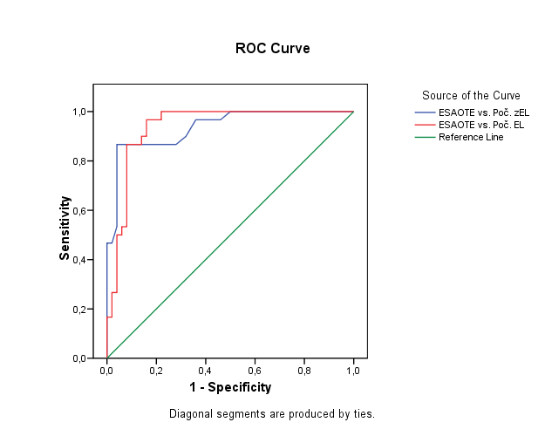

Slide 32
Automatic measurement: κ = 0.787 (95% CI: 0.648 – 0.926), AC1 = 0.812 (P<0.0001)
Manual measurement: κ = 0.762 (95% CI: 0.615 – 0.909), AC1 = 0.787 (P<0.0001).
Optimal cut-off value for automatic measurement +0.04 (18.540) with 86,7% sensitivity and 92,0% specificity.
Optimal cut-off value for manual measurement +1.4 mm² (25,5 mm²) with 86,7% sensitivity and 96,0% specificity.

Slide 33
Evaluation of echogenicity of brain structures
Substantia nigra
Brainstem raphe
Red nucleus
Caudate nucleus
Lentiform nucleus
Thalamus
Insula
Dentate nucleus
Cerebral and cerebellar white matter
Medial temporal lobe

Slide 38
Digital Image Analysis enables to compare echogenicity of any predefined area of the brain between patients with severe neurodegenerative diseases and heathy subjects and also to monitor the changes of echogenicity of predefined brain structures during the course of disease (in defined time period)

Slide 39
Studies with Digital Image Analysis and TCS
Blahuta J, Soukup T, Jelinkova M, Bartova P, Cermak P, Herzig R, Skoloudik D. A new program for highly reproducible automatic evaluation of the substantia nigra from transcranial sonographic images. Biomed Pap Med Fac Univ Palacky Olomouc Czech Repub. 2014;158(4):621-7.
Školoudík D, Jelínková M, Blahuta J, et al. Transcranial sonography of the substantia nigra: digital image analysis. AJNR Am J Neuroradiol. 2014;35(12):2273-8.
Šilhán P, Jelínková M, Walter U, Pavlov Praško J, Herzig R, Langová K, Školoudík D. Transcranial sonography of brainstem structures in panic disorder. Psychiatry Res. 2015;234(1):137-43.
Hamerla G, Kropp P, Meyer B, Rocco A, Jürgens TP, Walter U. Midbrain raphe hypoechogenicity in migraineurs: An indicator for the use of analgesics but not triptans. Cephalalgia. 2016;37(11):1057-66.
Walter U, Skowrońska M, Litwin T, Szpak GM, Jabłonka-Salach K, Skoloudík D, Bulska E, Członkowska A. Lenticular nucleus hyperechogenicity in Wilson's disease reflects local copper, but not iron accumulation. J Neural Transm (Vienna). 2014;121(10):1273-9.
Mašková J, Školoudík D, Burgetová A, et al. Comparison of transcranial sonography-magnetic resonance fusion imaging in Wilson's and early-onset Parkinson's diseases. Parkinsonism Relat Disord. 2016;28:87-93.
Školoudík D, Bártová P, Mašková J, Dušek P, Blahuta J, Langová K, Walter U, Herzig R. Transcranial Sonography of the Insula: Digitized Image Analysis of Fusion Images with Magnetic Resonance. Ultraschall Med. 2016:37(06);604-8.
Walter U, Školoudík D. Transcranial sonography (TCS) of brain parenchyma in movement disorders: quality standards, diagnostic applications and novel technologies. Ultraschall Med. 2014;35(4):322-31.

Slide 40
Conclusion
Digitized image analysis (especially in combination with Fusion Imaging technique) enables the quantitative evaluation of echogenicity of several brain structures, detect increased or decreased echogenicity or changes in echogenicity in time (course of disease).

Slide 41
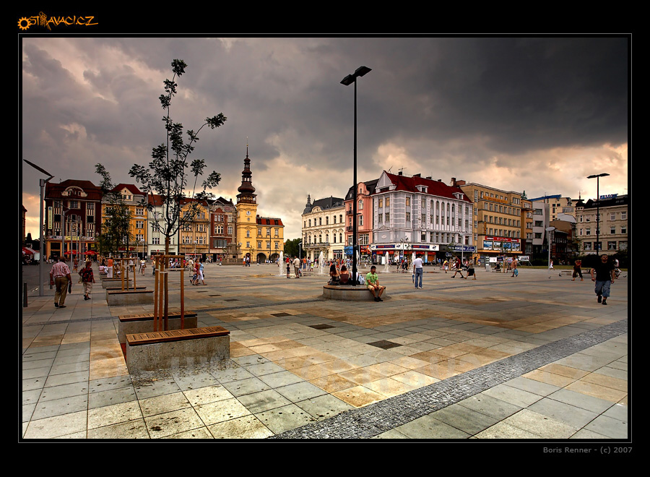
Thank you for your attention

